Slide 1

Populism and austerity
Manos Matsaganis
Polytechnic University of Milan
Friedrich Ebert Foundation seminar
“Voting for far-right and right-wing populist parties: Spatial perspectives”
Villa Vigoni, Menaggio (19-21 June 2025)

Slide 2
Inequality and populism
A causal relationship?

Slide 3
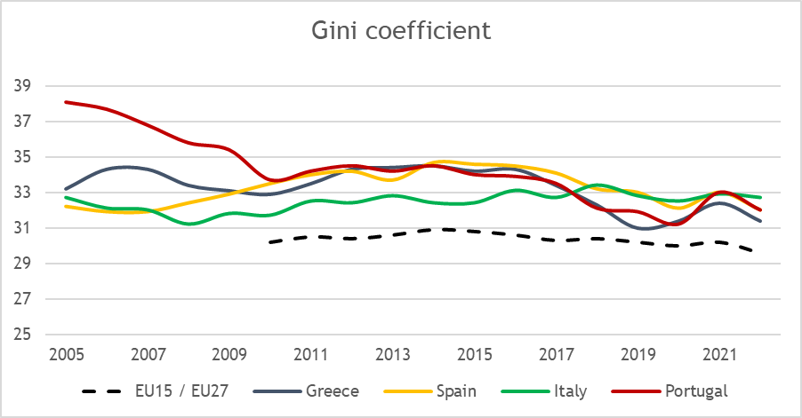
Inequality rising?

Slide 4
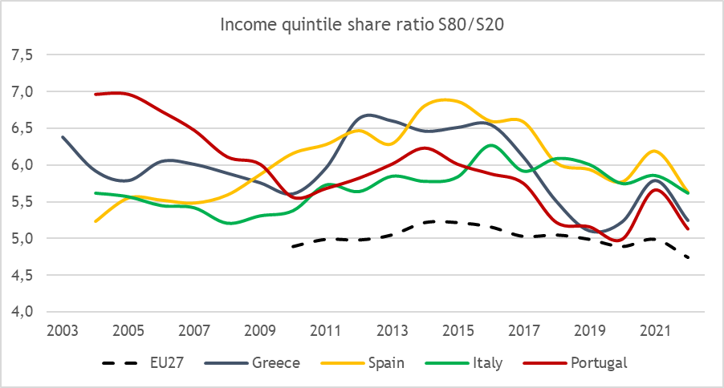
Inequality rising?

Slide 5
Rising populism
More complex:
  Sudden loss of status
  +
  Sense of betrayal

Slide 6
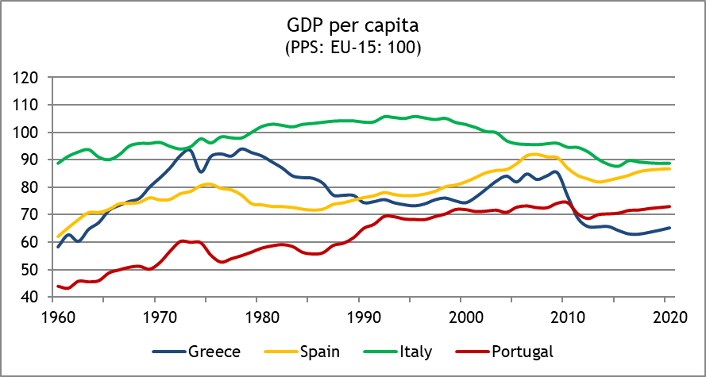
Sudden loss of status?

Slide 7
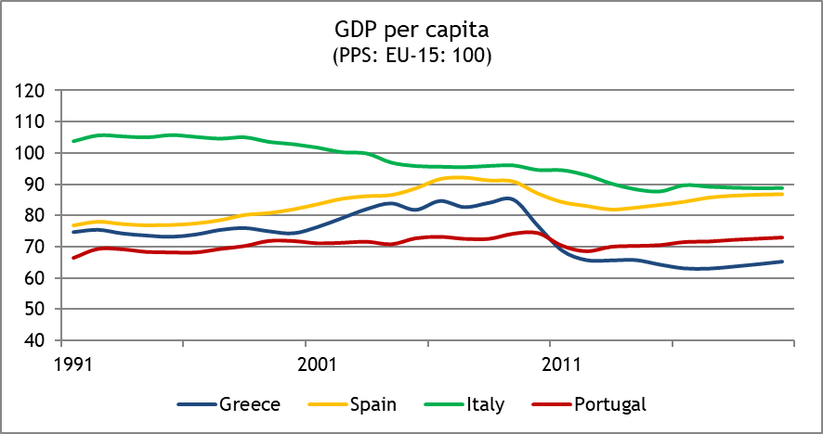
Sudden loss of status?

Slide 8
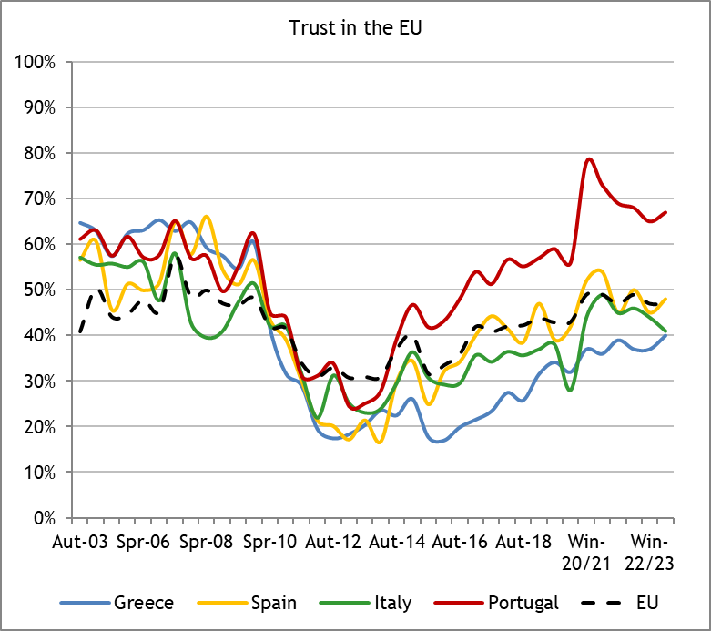
Sense of betrayal?

Slide 9
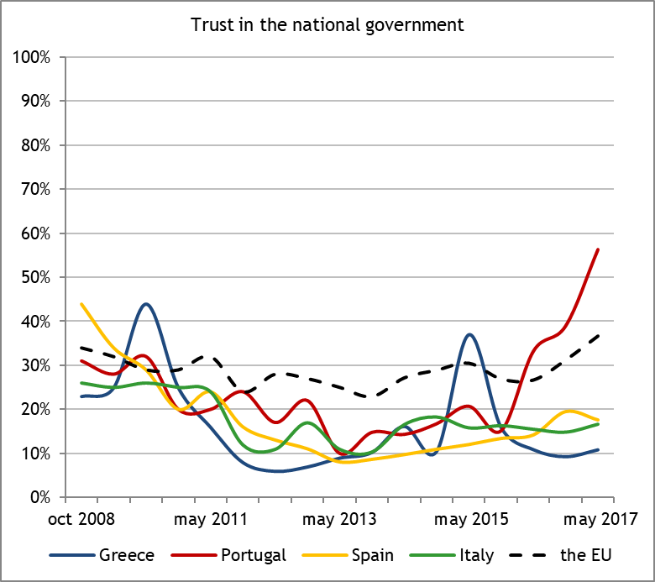
Sense of betrayal?

Slide 10
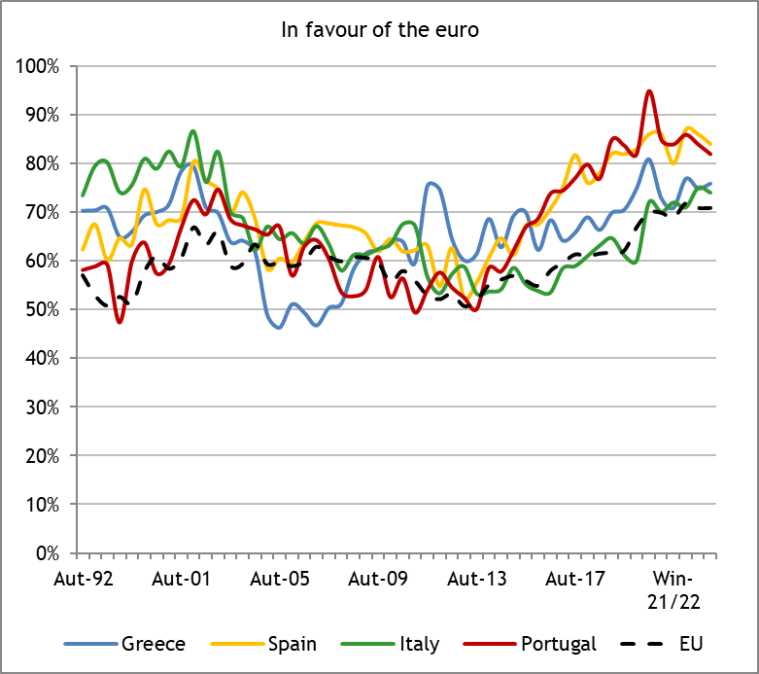
Sense of betrayal?

Slide 11
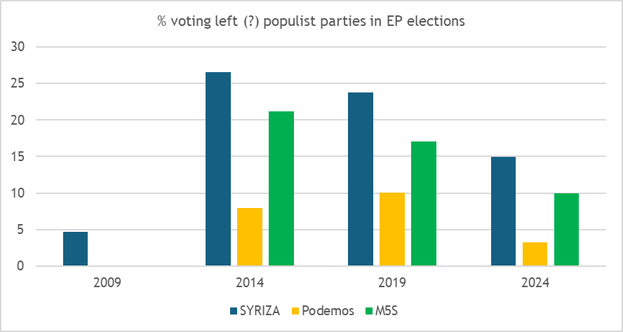
The rise and fall of left populist parties

Slide 12
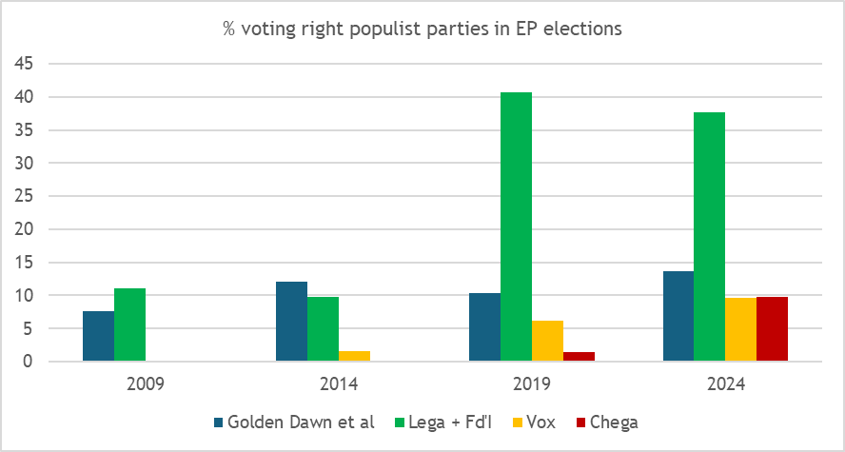
The rise and rise of right populist parties

Slide 13

Writings
On the political economy of the Euro crisis:
Hemerijck A. & Matsaganis M. (2024) The legacy of the Eurozone crisis. In: Who’s afraid of the welfare state now? Oxford: Oxford University Press.
Perez S.A. & Matsaganis M. (2019) Export or perish: can internal devaluation create enough good jobs in Southern Europe? South European Society and Politics 24 (2) 259-285.
Perez S.A. & Matsaganis M. (2018) The political economy of austerity in Southern Europe. New Political Economy 23 (2) 192-207.
Matsaganis M. (2018) Making sense of the Greek crisis, 2010-2016. In: Europe’s crises (edited by M. Castells et al.) Cambridge: Polity.

Slide 14
Writings
On the distributional implications of the Euro crisis:
Matsaganis M. & Leventi C. (2014) The distributional impact of austerity and the recession in Southern Europe. South European Society and Politics 19 (3) 393-412.
Matsaganis M. & Leventi C. (2014) Poverty and inequality during the Great Recession in Greece. Political Studies Review 12 (2) 209-223.
Matsaganis M. & Leventi C. (2013) The distributional impact of the Greek crisis in 2010. Fiscal Studies 34 (1) 83-108.
Matsaganis M. (2011) The welfare state and the crisis: the case of Greece. Journal of European Social Policy 21 (5) 501-512.

Slide 15
Writings
On populism in Greece:
Matsaganis M. (2024) Ragioni (e stagioni) dell’antieuropeismo di sinistra in Grecia. In: Europa anni ’20: Quadri del nuovo millennio (edited by G. Arrigo). Milano: Mimesis Edizioni.
Matsaganis M. (2016) To the brink and back in Greece. Current History 115 (779) 108-113.
Matsaganis M. (2014) The catastrophic Greek crisis. Current History 113 (761) 110-116.
Doxiadis A. & Matsaganis M. (2012) National populism and xenophobia in Greece. In: The threats of populism: Europe’s reluctant radicals (edited by C. Fieschi, M. Morris, L. Caballero). London: Counterpoint.

